Slide 1

Welcome to Year 2

Slide 2

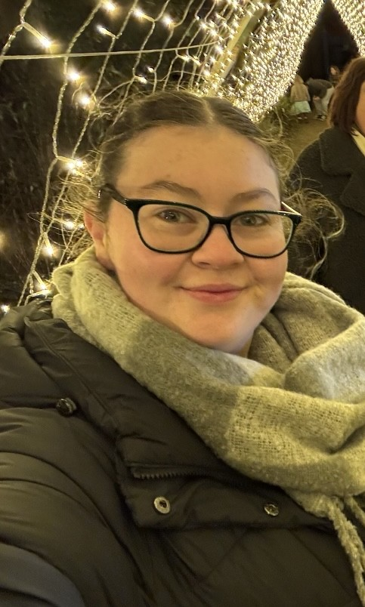
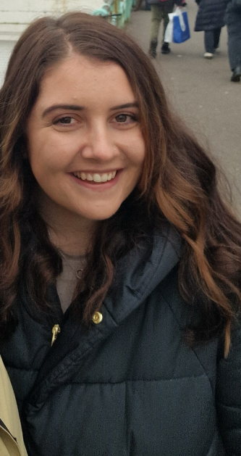
The Year 2 team
Monday
Tuesday
Wednesday mornings
Wednesday afternoon
Thursday
Friday
Miss Webb
lwebb@cameverlands.org.uk
Mrs Farrier
mfarrier@cameverlands.org.uk

Slide 3
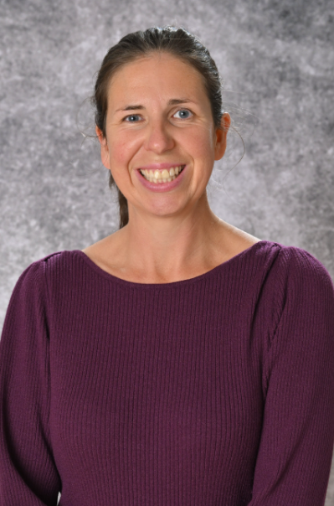
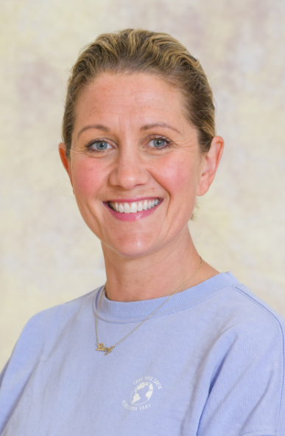
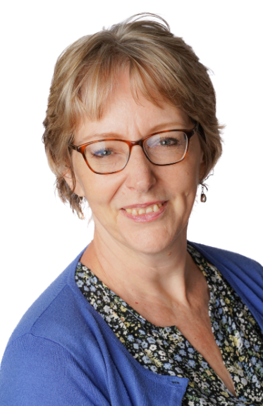
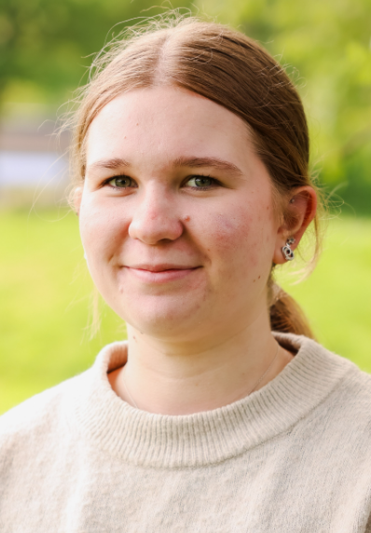
The Year 2 team
Mrs Coulsting
Miss Green
Mrs Mack
Mrs Brown

Slide 4

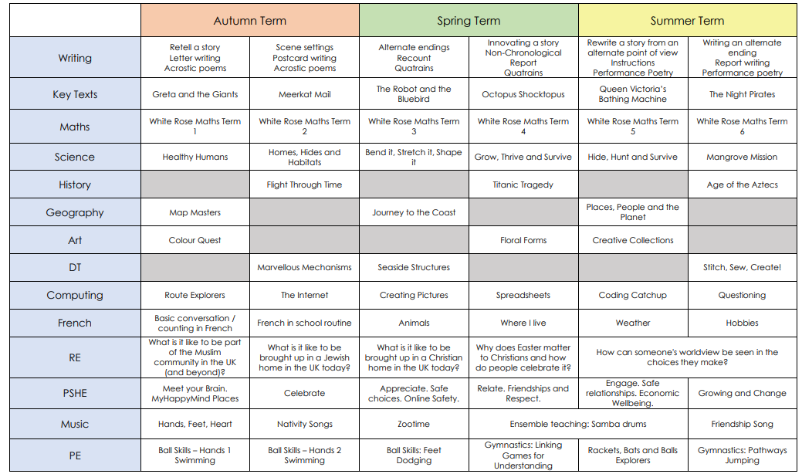
The Year 2 Curriculum

Slide 5

Year 2 routines
Children need to bring book bag and reading record every day
Books will be changed on a Monday morning.
This term, PE is on Tuesday afternoons (swimming) and Friday afternoons (outdoor). This is subject to change throughout the terms. We will let you know of any changed via email, Dojo and the class page on the website.

Slide 6
Highlights of the year
Swimming (Term 1)
Trip to Westonbirt (Term 1)
Trip to Aerospace Bristol (Term 2)
M&M Theatre Company in October and March
Nativity performance in December
Titanic Day (Term 4)
Whole class music teaching (Samba Drums)

Slide 7
Home learning expectations
Reading
Please read with your child everyday or at a minimum 5 times a week.
Spelling Shed later in the Year (likely around January)
Homework Grid (optional activities related to learning)

Slide 8

Key Dates
9th October - settling in reports sent home
14th & 15th October - Parents’ evenings
23rd October – individual pupil photos
8th December - Year 1 and 2 Nativity
16th December - KS2 Christmas sing-a-long
12th February – mid-year reports sent home
24th & 25th February – parents’ evenings
22nd & 23rd March – Y3 & 4 performance
5th May – class photos
10th May – Y6 SATs week
7th June – Y4 MTC week
10th June – Sports Day
14th June – Y1 Phonics check week
8th July – Y5&6 performances
12th July – end of year reports out
14th July – optional parents’ evening

Slide 9
Where to get information
Class Dojo app
Via emails
School website (especially class pages)
Cam Everlands Facebook page
Come and ask!

Slide 10
Any questions?

