Slide 1

Welcome to Year 3

Slide 2

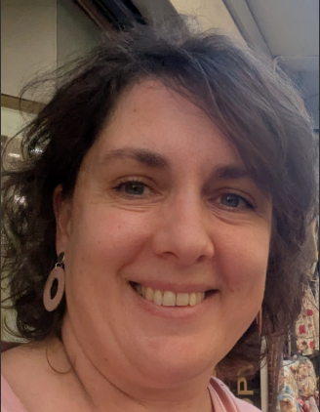
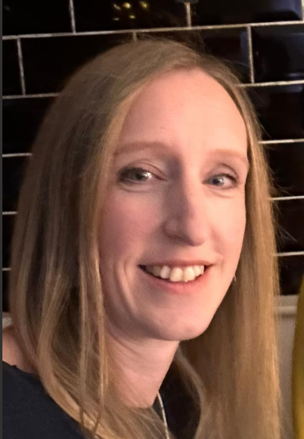

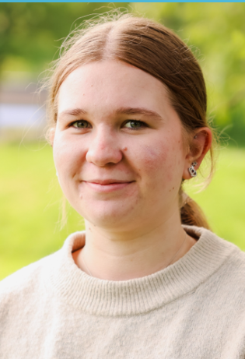
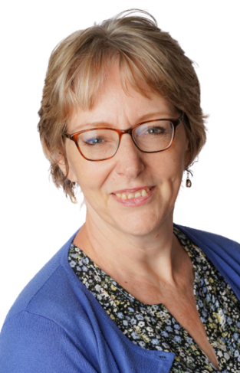
The Year 3 team
Mme Brunet
Mrs Beasley
Mr Kinsley
Miss Green
Mrs Brown

Slide 3

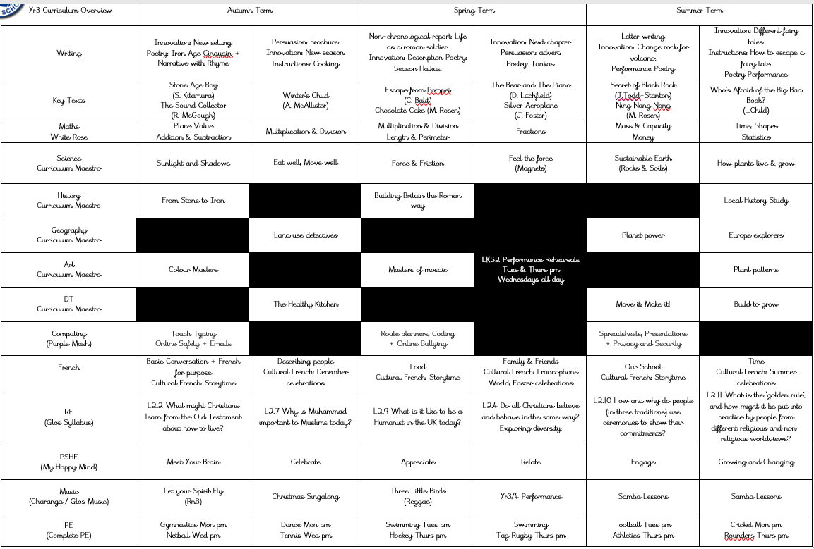
The Year 3 Curriculum

Slide 4

Year 3 routines
Children need to bring reading book and record book every day
PE is on Monday (gymnastics) and Wednesday (netball) afternoons.

Slide 5
Highlights of the year
Swimming in Terms 3 & 4
Trip to Caerleon in Term 3
M&M Theatre Company in October and March
Christmas Singalong in December
Yr3 & yr4 show at the end of Term 4
Whole class music teaching in Term 5 and 6 – samba tbc

Slide 6
Home learning expectations
Reading: Please aim to listen to your child read every day. If they are fluent readers, they can read on their own but it is important to discuss what they have on a regular basis.
Times tables: As per term letter, please try to help your child learn and retain these.
Spelling Shed: weekly activities which the children can access independently, linked to the focus words for the week.
Rollama: grammar games and activities

Slide 7

Key Dates
9th October - settling in reports sent home
14th & 15th October - Parents’ evenings
23rd October – individual pupil photos
16th December - KS2 Christmas sing-a-long
12th February – mid-year reports sent home
24th & 25th February – parents’ evenings
22nd & 23rd March – Y3 & 4 performance
5th May – class photos
10th June – Sports Day
12th July – end of year reports out
14th July – optional parents’ evening

Slide 8
Where to get information
Class Dojo app: for calendar dates.
Via emails
School website (especially class pages)
Cam Everlands Facebook page
Come and ask!

Slide 9
Any questions?

