Slide 1

KS2 Parent Information
September 2024

Slide 2
We have 2 key principles at Cam Everlands
Everyone has the right to feel safe, valued and respected
  Everyone has the right to learn and teach free from the disruption of others

Slide 3
This means…
Nobody has the right to make anyone else feel unsafe, not valued or disrespected
  Nobody has the right to stop anyone else learning or teaching by being disruptive

Slide 4

Cam Everlands Goals
The Cam Everlands Goals will help you be a great learner.

Slide 5
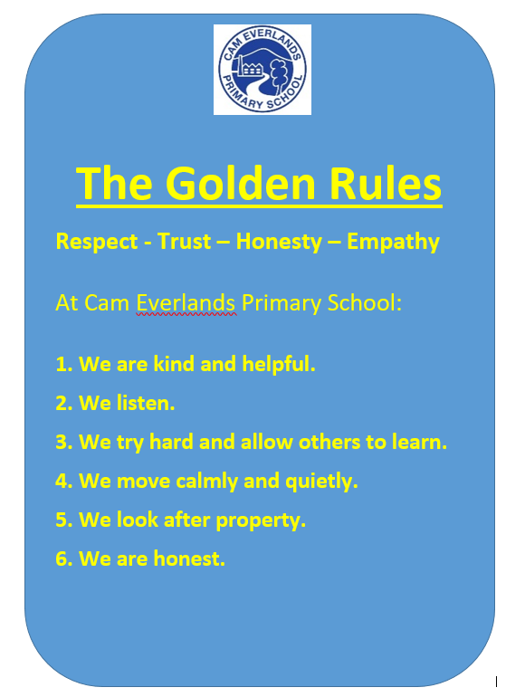
Behaviour

Slide 6

Class Dojo
We are now using Class Dojo as a reward system for the children to reward positive behaviour
If you’ve signed up, you can get notifications when your child gets a reward
Individual points go towards a personal reward
Emails are still the best way to contact staff (although please be mindful that staff may not respond between 5pm and 8am)

Slide 7
Why is reading so important?
The EEF report the lifelong consequences of poor language development:
Five-year-olds with poor vocabulary are three times more likely to have mental health problems as adults
And are twice as likely to be unemployed in adulthood
65% of young people in young offender institutions have communication difficulties
Children from low-income families lag behind high-income counterparts by 19 months in vocabulary

Slide 8
Why do we read?
Reading for pleasure is more likely to determine whether a child does well at school than their social or economic background.
Imagination and fun
Faster development of communication and speech
Enhanced concentration and discipline.
Cultural understandings.
Higher academic performance.
Nurturing the parent and child bond.

Slide 9

Reading in School
The children will be given the opportunity to independently read every day (Reading for pleasure).
We aim to teach the whole class reading at least four times a week.
In Key Stage 2, we focus on fluency and both verbal and written comprehension, and we ask that when you are reading with your child at home that you ask them lots of questions.
All classes will aim to read a story to the children at least once per day.

Slide 10
Aspiring Reading
Programme
At Everlands, we take part in a reading challenge. Children are asked to read at home at least 5x per week on different days.
Key Stage 2 Reading Rewards
5 days a week at home in a week. | Reading stamp in Learning Diary.
11 x 5 reads per week. | 11 Dojo Points.
22 x 5 reads per week. | Certificates.
33 x 5 reads per week. | Book Prize.
44 x 5 reads per week. | Dedicated Readers Medal.

Slide 11

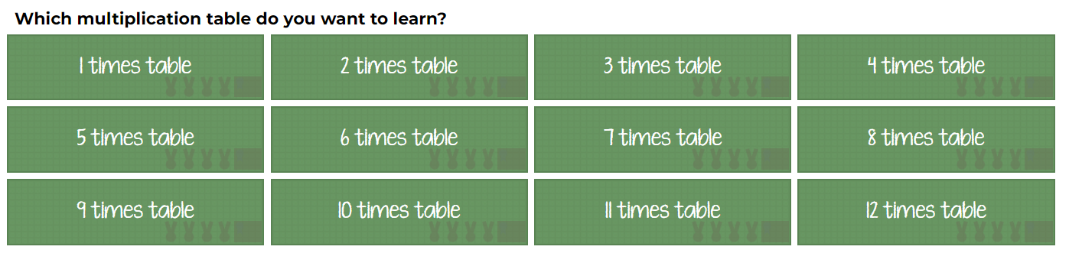
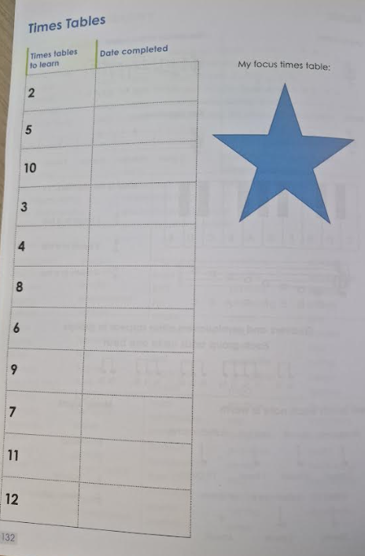
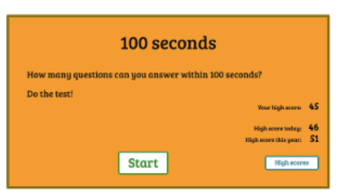
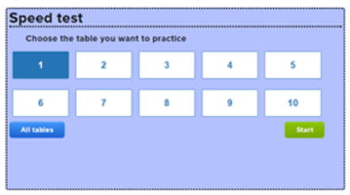
Multiplication at Cam Everlands
Change from previous ‘99 club’ system
Range of activities daily with a
‘focus’ table
Check ins to see when ready to
progress
Free, no log in required, can be as
quick as 100 seconds!

Slide 12

Spellings
We actively try to teach spelling through focusing on sounds and word structure. Part of the school day is designated for this instead of ‘Look Cover Write Check’ sheets going home.
We use ‘Spelling Shed’ that the children should use to support their learning at home.

Slide 13
Class Structure
KS2 is arranged into 4 classes
Year 3
Teacher: Mrs. Brunet-Lua, Mrs. Bright
T.A.: Mr. Kinsley,
Year 4
Teacher: Mrs. Farrier
T.A.: Mrs. Maddison,
Year 5
Teacher: Mrs Sinclair & Mrs Bright
T.A.: Mrs Stephens
Year 6
Teacher: Mrs Beasley, Mr Payne
T.A.: Ms Stock

Slide 14

P.E.
Swimming is on a Tuesday afternoon each week. Year 6, 5 and 4 are swimming in term 1 & 2. Year 3 will learn in term 3-4 and Year 2 will learn in term 5-6.
P.E. kit:
Indoor kit: Plain blue or black sweatshirt and jogging bottoms.
Plain black or blue shorts.
Plain t-shirt of your child’s house colour.
Trainers for P.E.
We would ask that children do not wear multi-coloured, sparkly or fashion items for their PE lessons.
Hair ties
Earrings: Studs only.

Slide 15
Food and drink
We are a nut-free school – please do not send in food and snacks which contain nuts
All snacks which are sent in should be healthy e.g. fruit, vegetables, NOT crisps and chocolate
We want children to be hydrated but children should only be drinking water in school

Slide 16

Homework
Reading is non-negotiable and needs to happen 5x a week.
Mangahigh and spelling activities (Spelling Shed) will be set weekly. Children will be given reward points for completing these tasks.

Slide 17
Other reminders
Unless explicitly agreed to by school, children should not bring toys to school
Again, unless specified on a plan, children should not be bringing fidget toys into class

Slide 18
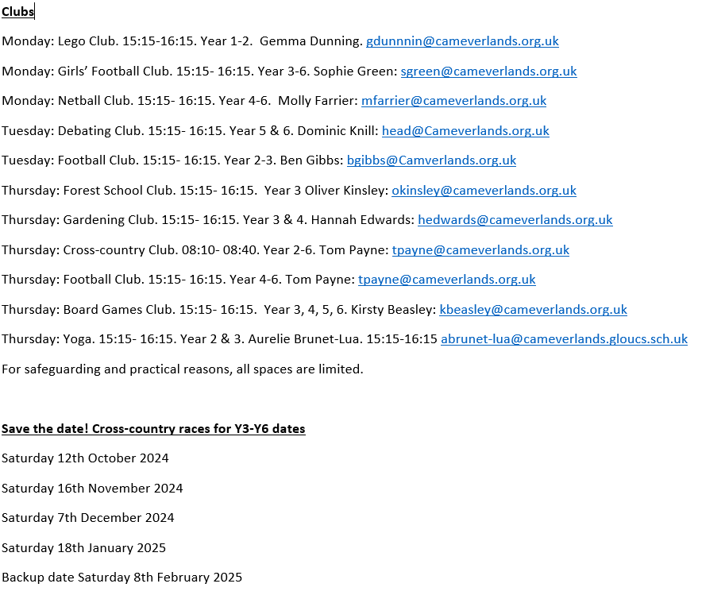

Slide 19
Key Dates
15/10/24- 16/10/24 Parents Evening
TBC School Association Disco
4/11/24 - 8/11/24 Y6 Residential
TBC Christmas Fayre
25/2/25- 26/2/25 Parents Evening
12/5/25 Y6 SATs week begins
5/6/25 Sports Day
9/4/25 Y3/Y4 Production
9/7/24 Y5/Y6 Production
14/7/24 End-of-year reports

Slide 20
Any Questions?
If you have any questions, we will all go to our classrooms to speak to you individually.
Thank you very much. ☺

