Slide 1
Year 1 Open Evening
September 2025

Slide 2
Tonight we will talk about
Phonics and Reading
Writing
Maths
Further into the Curriculum
Zones of regulation
Use of Monster Dojo
Special Events
Helping In School
Helping From Home

Slide 3

Phonics and Reading
The national curriculum says that: …
“Re-reading a text gradually increases the number of words in it that they can read ‘at a glance.”
It aims to: ...
“develop the habit of reading widely and often, for both pleasure and information.”
We teach:
Daily phonics using Unlocking Letters and Sounds.
Guided reading through ULS
Notes:
NOTE: To change images on this slide, select a picture and delete it. Then click the Insert Picture icon in the placeholder to insert your own image.

Slide 4
Phonics and Reading
Phase 4
Phase 4 is a very important stage. Although we do not introduce any new phonemes and graphemes, it gives the children the vital time to practice what they have learnt in the fast-paced Phases 2 and 3.
Grammar is also introduced. The children start to discuss nouns, verbs and adjectives and how to add suffixes and prefixes.
Sight words
said have like so do some come little
one were out what when there

Slide 5
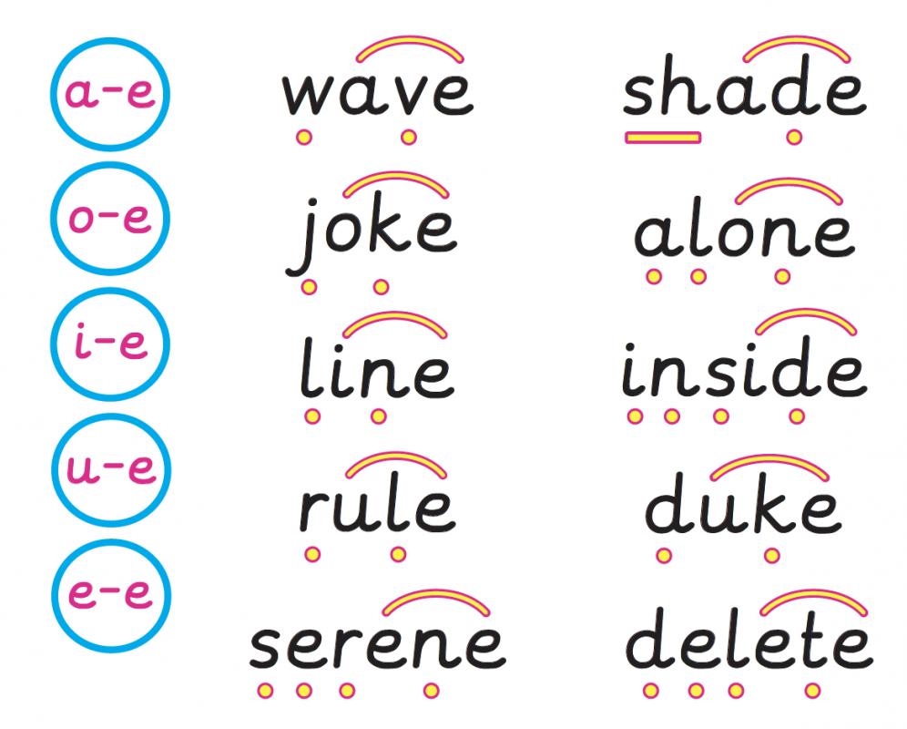
Phonics and Reading
Phase 5
We learn alternative sounds:
ay oy ie ea ir ue aw wh ph ew oe au
ey ou ch (as a c and a sh) , soft c, Y (as I, e and i) g (as j)
Some of these are split digraphs:
a_e i_e u_e
Long vowel sounds:
a e i o u
Sight words
could should would want oh their Mr Mrs
love your people looked called asked water where
who why thought through
Key skills:
reading polysyllabic words –
eg children, shampoo, tonight

Slide 6

What do we do to support phonics and reading in school?
Daily phonics lessons – including breaking down and reading a sentence
Phonic interventions as needed
Weekly guided reading
Reading buddy scheme with Year 6
Volunteers to come and hear readers
Incentives for reading and homework

Slide 7

How can you support your child in reading and phonics?
Daily reading
Teach Your Monster to Read for 5 mins 3 x week
Reading for pleasure
Eye check

Slide 8


Writing
This term, we will be continuing with Drawing Club structure, which the children are used to from Reception.
Children are introduced to handwriting lines and asked to think carefully about their letter formation.
Notes:
NOTE: To change images on this slide, select a picture and delete it. Then click the Insert Picture icon in the placeholder to insert your own image.

Slide 9

Writing
In term 2, Year 1 will be invited on The Curious Quests by Prof Klunk. We will teach Prof Klunk how to write sentences with capital letters and full stops, as well as ? And !, how to use interesting words and how to use ‘ed’ to say something has already happened.
We continue to use a wide range of quality texts to inspire children to write.
At least once a term there will be a reason for their writing, e.g. to write a story for the new Reception.
Notes:
NOTE: To change images on this slide, select a picture and delete it. Then click the Insert Picture icon in the placeholder to insert your own image.

Slide 10
Writing
Writing uses a lot of different skills
Writing for independence
Good phonetical spelling
Accurate spelling of common exception words
Use of interesting and varied vocabulary.
Writing for different occasions
Good phonetical spelling
Children are not expected to spell 100% accurately but have plausible phonetic attempts.
Accurate spelling of common exception words
Children’s practice of common exception words should be reflected in their writing.
Interesting vocabulary
In Year 1, we try to work on vocabulary a lot by reading many books and discussing different words that we could use to mean the same thing.
Writing for different occasions
Children are not required to write for different occasions until Year 2 but in Year 1 we will introduce children to letters, fact files, recounts and poetry as well as stories. Through this we can add interest and reason to their writing, as well as considering more varied vocabulary.

Slide 11
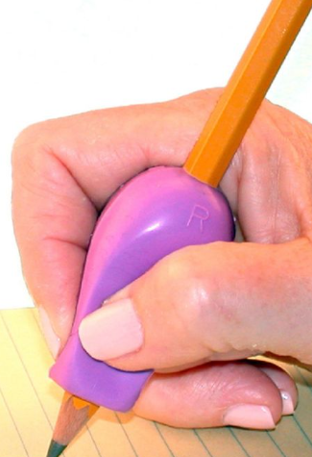
What do we do to support writing in school?
Daily phonics lessons – including writing sentences 2 x week
Phonic interventions as needed
By term 2, daily writing lessons
Independent writing opportunities i.e. letters to Banjo
Interventions to build hand muscles
Writing across subjects

Slide 12
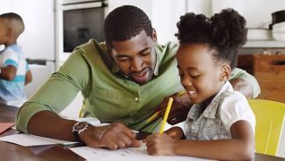
How can you support your child in writing?
Build hand muscles – playdough, Lego, pegs
Give reasons for writing – cards, shopping list
Reinforce letter formation

Slide 13
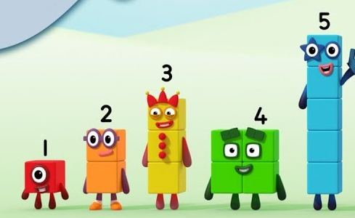
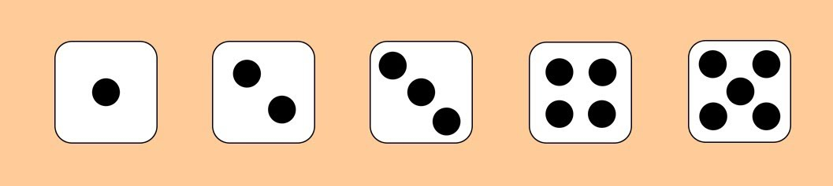

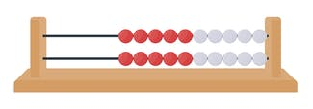
Early Maths
Subitising
By Heart
This is a skill that children develop to recognise numbers without counting.
This is a skill where children can use their subitising and number experience to begin to remember number facts by heart

Slide 14
Maths
Autumn term we will be looking at:
Place value within 10
Addition and subtraction within 10
Shape
Spring term we will be looking at :
Place value within 50
Addition and subtraction within 20
Measurement – length, height, volume
and weight
Summer term we will be looking at :
Place value within 100
Multiplication and division
Fractions
Directions
Money
Time

Slide 15
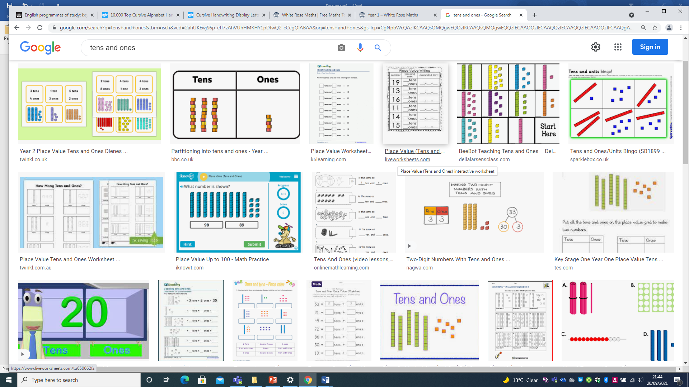
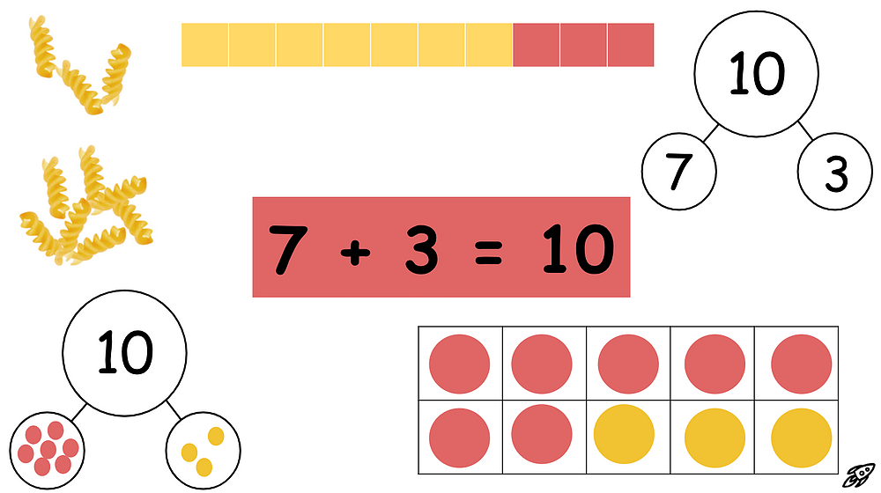
Maths
Tens and ones
Number bonds
Showing an understanding of number so that there is a solid understanding of calculations as they become more tricky.
Knowing the pairs of numbers that go together to make 10 can then be used with larger numbers.

Slide 16

What do we do to support maths in school?
Daily maths lessons
Quick maths mastery lessons – deepen and embed understanding of number
Maths challenges and opportunities within the environment
Several GECKO maths competitions throughout the year.
Maths interventions as needed

Slide 17
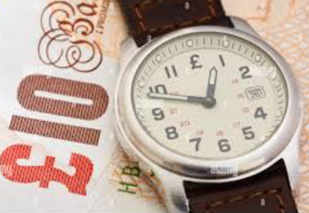
How can you support your child in maths?
Teach Your Monster to Maths Skills for 5 mins 3 x week
Encourage use of coins
Make reference to the time on a analogue clock

Slide 18
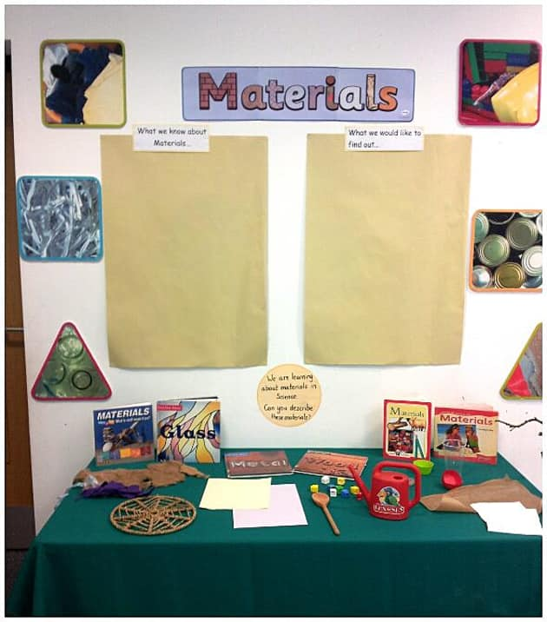


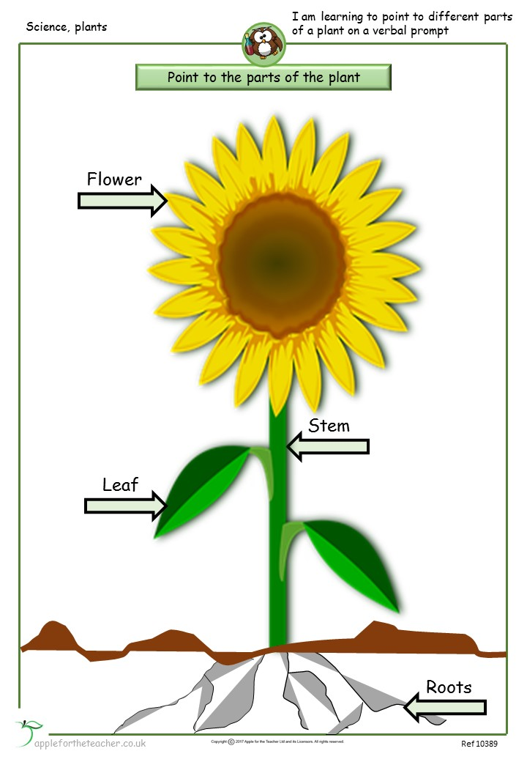

Science
Animals
Human senses
Materials
Seasonal changes
Plants

Slide 19

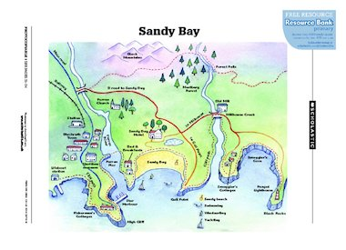
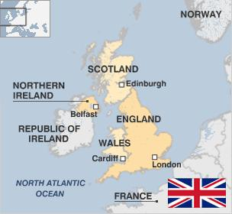
Geography
Banjo Robinson is our cat penpal
who will be writing to us from his
around the world travels. He will tell
us about landmarks he has seen,
food he has tasted and experiences
he has had.
In Year 1, we learn the countries,
capital cities and seas of the UK.
We will be looking at maps, how to
read and draw them. The children
will learn about geographical
landmarks such as harbours, cliffs,
cities, towns, etc

Slide 20
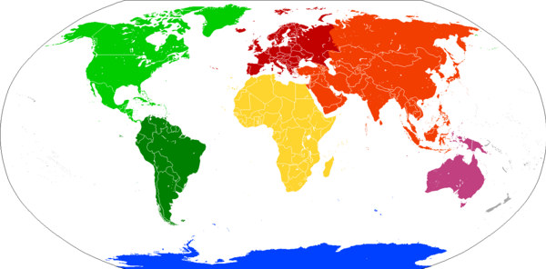

Geography
The children will consider
different types of settlements
and how villages, towns and
cities differ.
Children will learn the names of the 7
Continents and where they are
around the world.

Slide 21
Further into the Curriculum
What else do we get up to?
Termly curriculum letters
The learning that children gain from the teacher will be placed into continuous provision for them to explore and extend their understanding at their own pace. Staff members will be on hand to support with this.

Slide 22
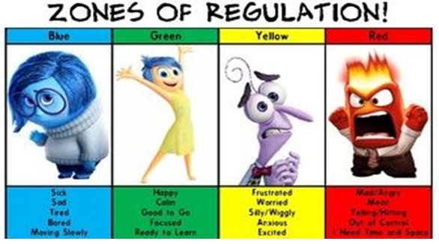
Children learn to recognise their feelings and how their body feels at
the time.
There is no shame, all feelings are valid. The children will work on finding
a way of managing their emotions.

Slide 23

Use of Monster Dojo
Use of Monster Dojo
We continue to use Monster Dojo to reinforce positive behaviour and as a form of communication.
In Year 1, children will start to be expected to do more of their own recording of their learning. However, we will endeavour to record as much of their practical learning as we can through their portfolios on Monster Dojo.

Slide 24





Year 1 routine
Morning starter
Phonics
Play project cycle – at the table with a teacher and challenges around the environment
As the year goes on we will become more structured, in readiness for Year 2. However, continuous provision will continue to be part of our routine throughout Year 1.

Slide 25
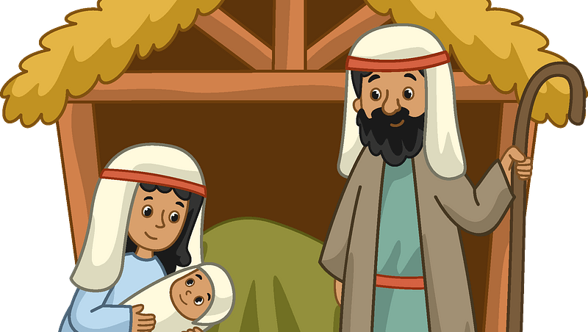
Special Events
1950’s day – Thursday 23rd October
Slimbridge trip – Friday 21st November
Nativity – Tuesday 9th and Wednesday 10th December
Class trip examples that are in walking distance and free – church, woodlands, local environment
Class trip examples that involve a coach ride and voluntary donation (half price for families that qualify for Free School Meals (not Universal free school meals that all infant children receive)
Puxton Park
Beach
Notes:
NOTE: To change images on this slide, select a picture and delete it. Then click the Insert Picture icon in the placeholder to insert your own image.

Slide 26

Helping in school
From Term 2 we welcome parent helpers to support learning in class on Wednesdays and Thursdays
Arts and crafts
Number and phonic games
Reading
Please speak to Mrs Dunning about arranging sessions.
Notes:
NOTE: To change images on this slide, select a picture and delete it. Then click the Insert Picture icon in the placeholder to insert your own image.

Slide 27

Helping at home
The most vital thing you can do at home is to support your child’s development in reading.
Termly letters will give suggestions as to activities that you can do to help support your child’s learning.
We will send home things to support your child’s learning as and when needed.
Notes:
NOTE: To change images on this slide, select a picture and delete it. Then click the Insert Picture icon in the placeholder to insert your own image.

Slide 28
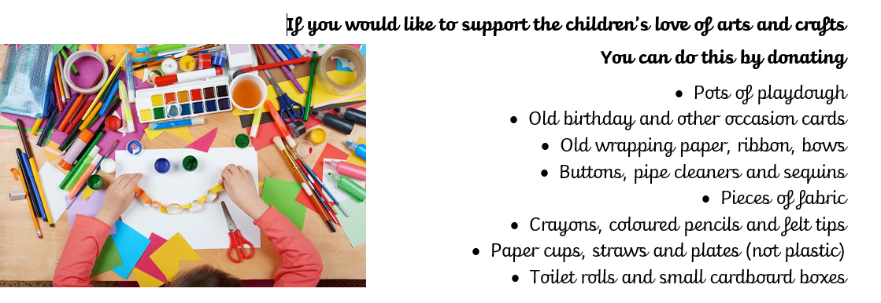
Donations – reduce, reuse and recycle

Slide 29
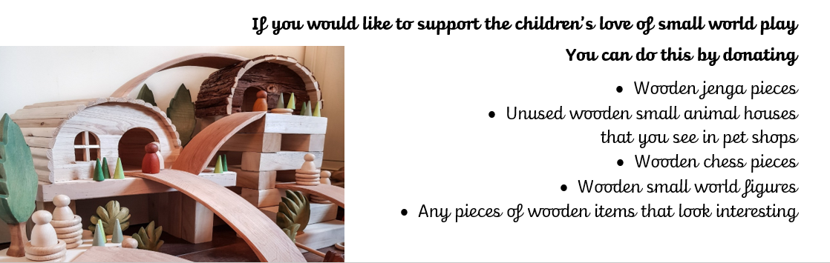
Donations – reduce, reuse and recycle

Slide 30
Thank you for coming tonight.
Feel free to have a look around the classroom and chat if you have any questions.

