Slide 1
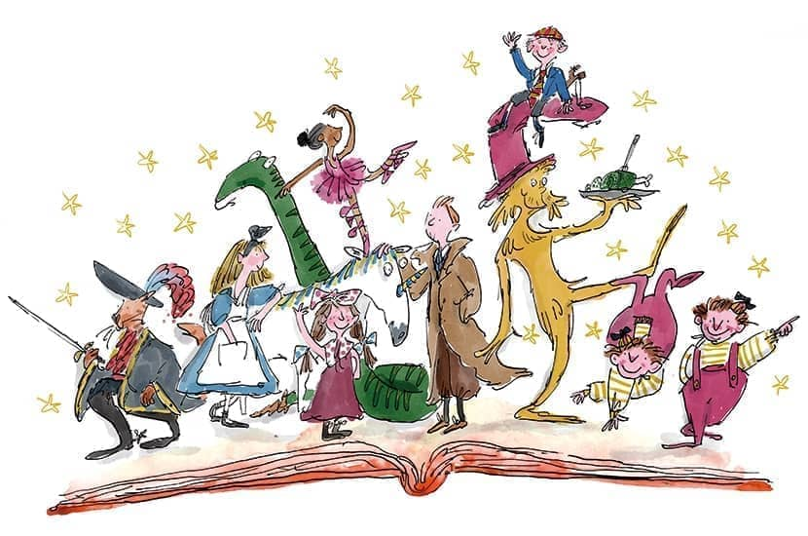
Phonics and Early Reading
September 2025
Notes:
NOTE: To change images on this slide, select a picture and delete it. Then click the Insert Picture icon
in the placeholder to insert your own image.

Slide 2
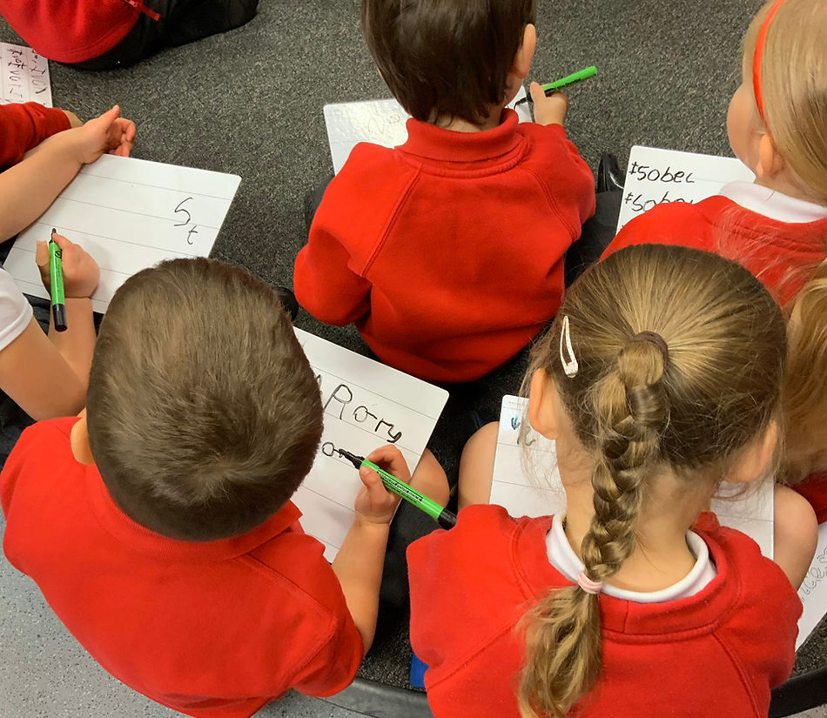
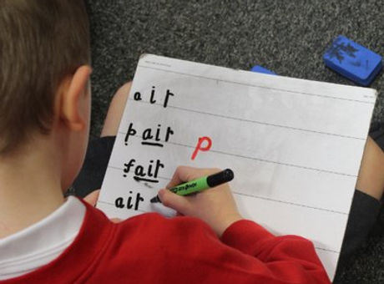
Our Phonics Scheme:
Unlocking Letters and Sounds
Notes:
NOTE: To change images on this slide, select a picture and delete it. Then click the Insert Picture icon
in the placeholder to insert your own image.

Slide 3



Runs in Phases across Reception, Year 1 and Year 2
EVERY day, for 30 minutes
Notes:
NOTE: To change images on this slide, select a picture and delete it. Then click the Insert Picture icon
in the placeholder to insert your own image.

Slide 4
Need to know vocabulary
Phoneme
The sound that a letter, or group of letters, make
Single letter phoneme
A phoneme made using 1 letter
eg. s p t
Digraph
Two letters that make one sound,
eg. ch sh
Trigraph
Three letters that make one sound
eg. igh

Slide 5
Need to know vocabulary
Letter name
The letter name you say when you sing the Alphabet Song
Common Exception Word
A word that you can not sound out using phonics
Syllable
The ‘beat’ of a word, eg. cat-er-pill-ar
Fluency
Being able to read by heart, with expression

Slide 6
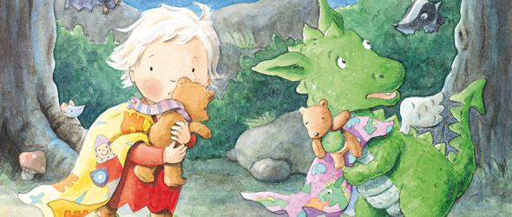
Reception – Phases 2, 3 and 4
Notes:
NOTE: To change images on this slide, select a picture and delete it. Then click the Insert Picture icon
in the placeholder to insert your own image.

Slide 7
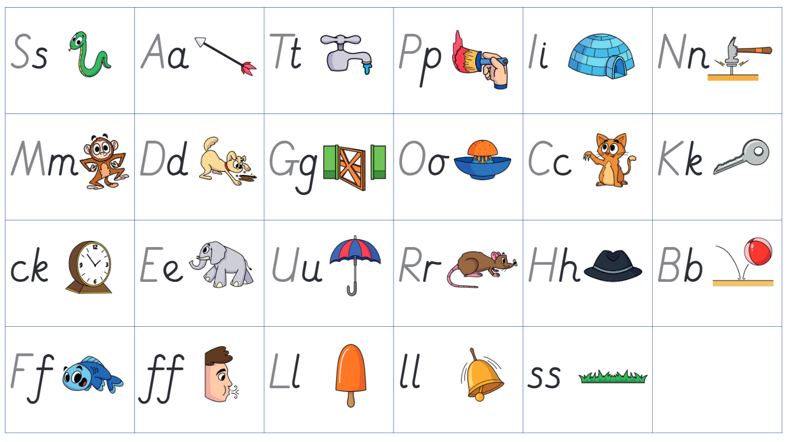
Phase 2

Slide 8
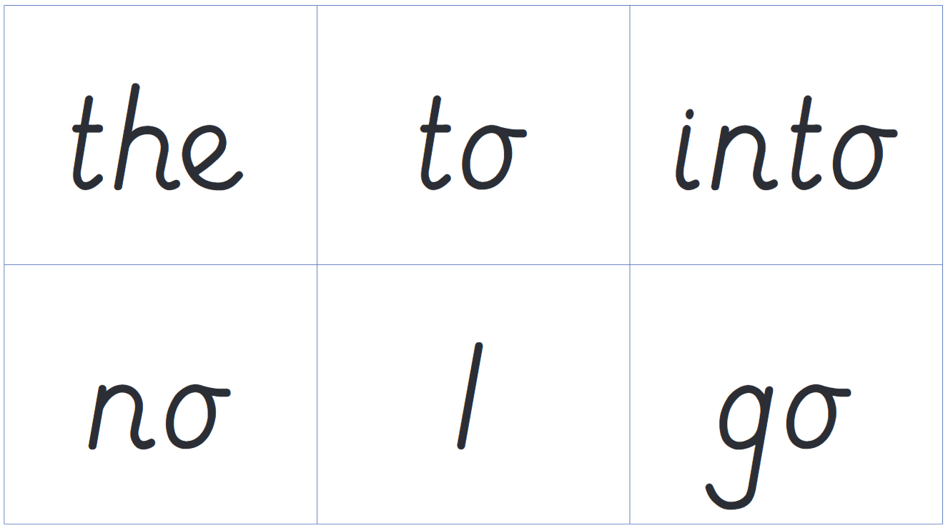
Phase 2

Slide 9
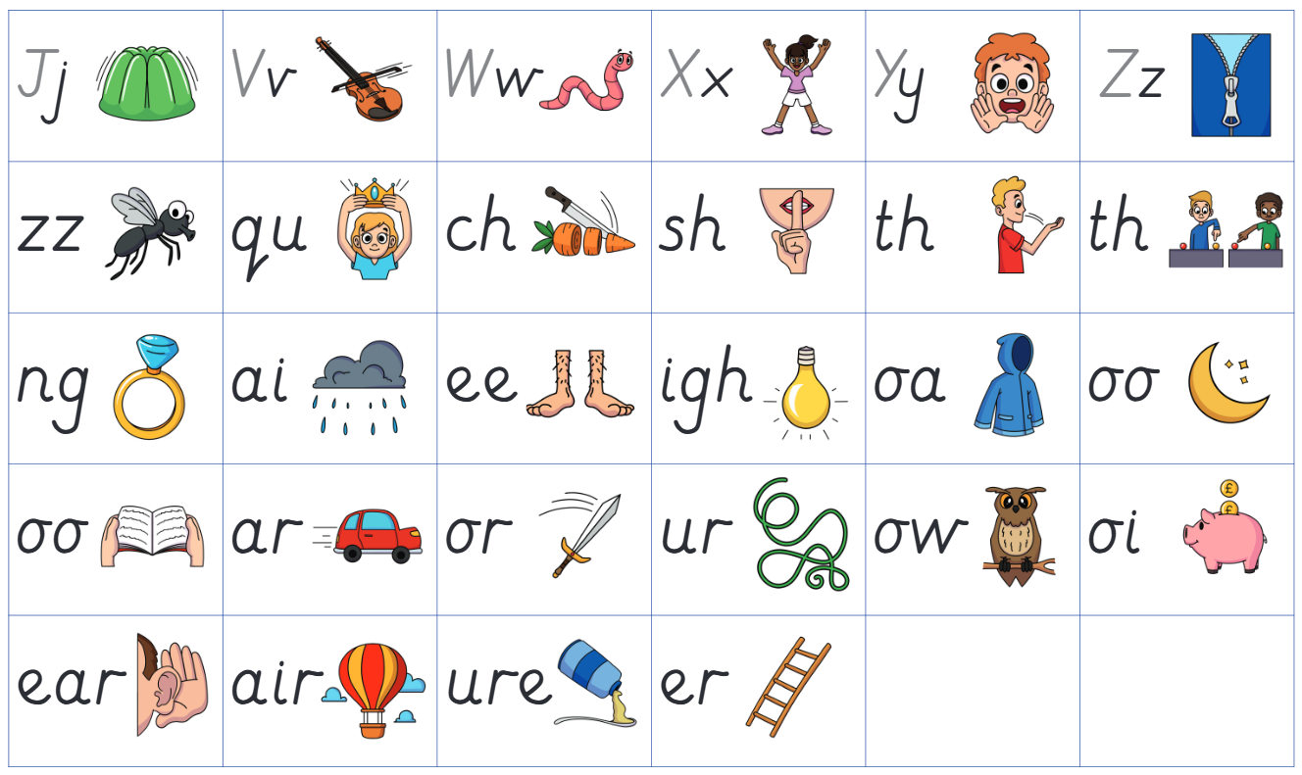
Phase 3

Slide 10
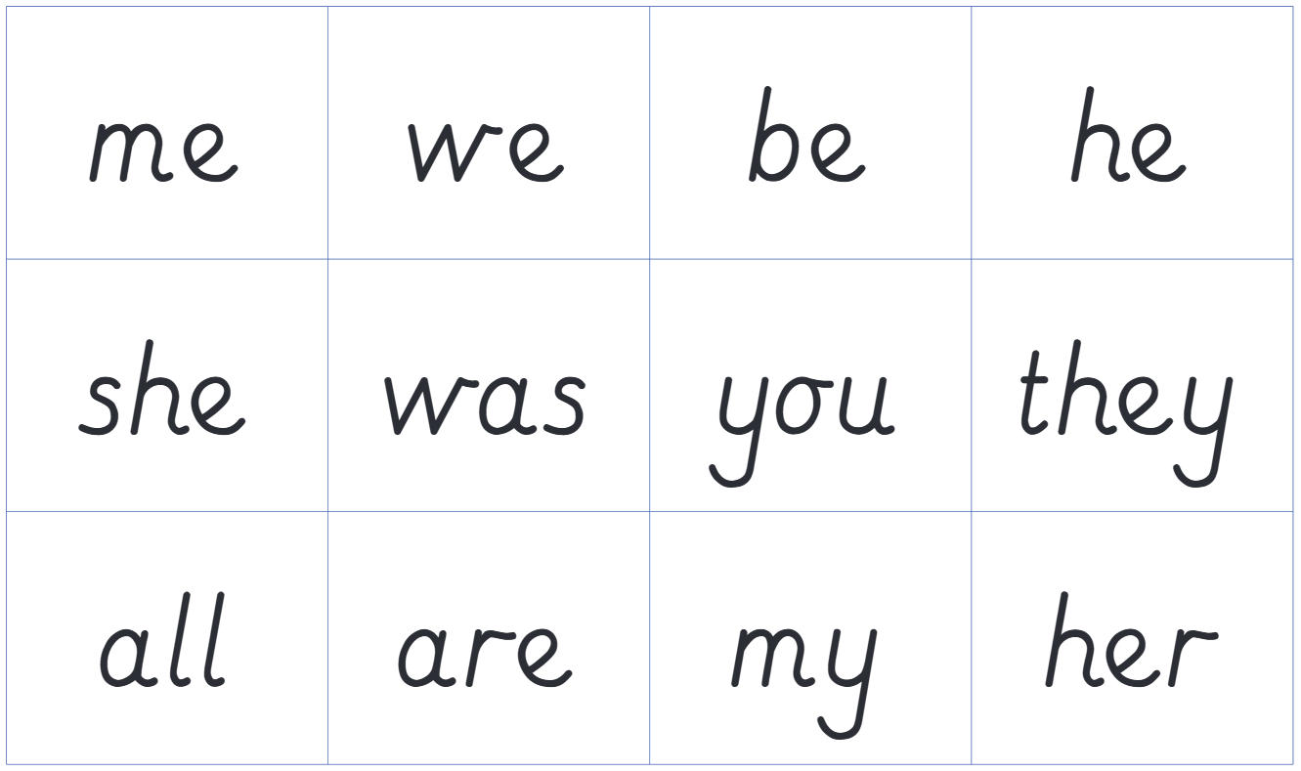
Phase 3

Slide 11
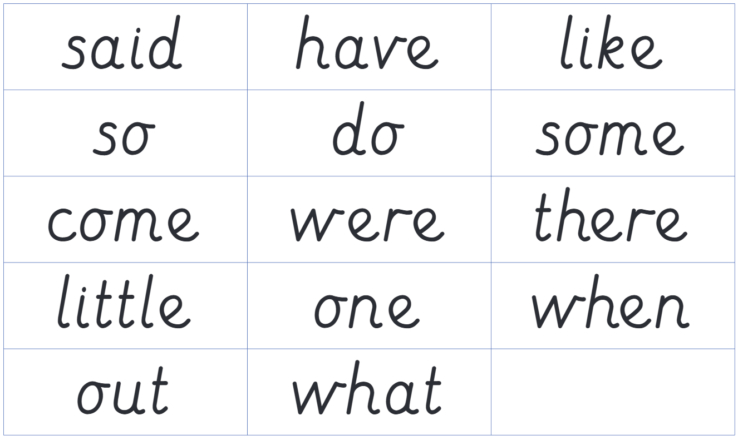
Phase 4

Slide 12
What single letter phonemes, digraphs and trigraphs can you see in this word?
buzzing

Slide 13
What single letter phonemes, digraphs and trigraphs can you see in this word?
hopscotch

Slide 14
What common exception words can you see in this sentence?
The cat went to the farmyard.

Slide 15
What common exception words can you see in this sentence?
Mum said, “It is going to rain soon.”

Slide 16
Progress in reading from
Phase 2 to Phase 4

Slide 17
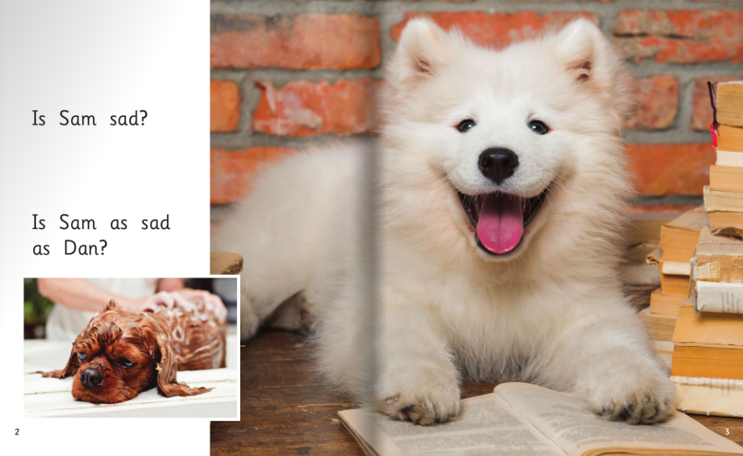

Slide 18
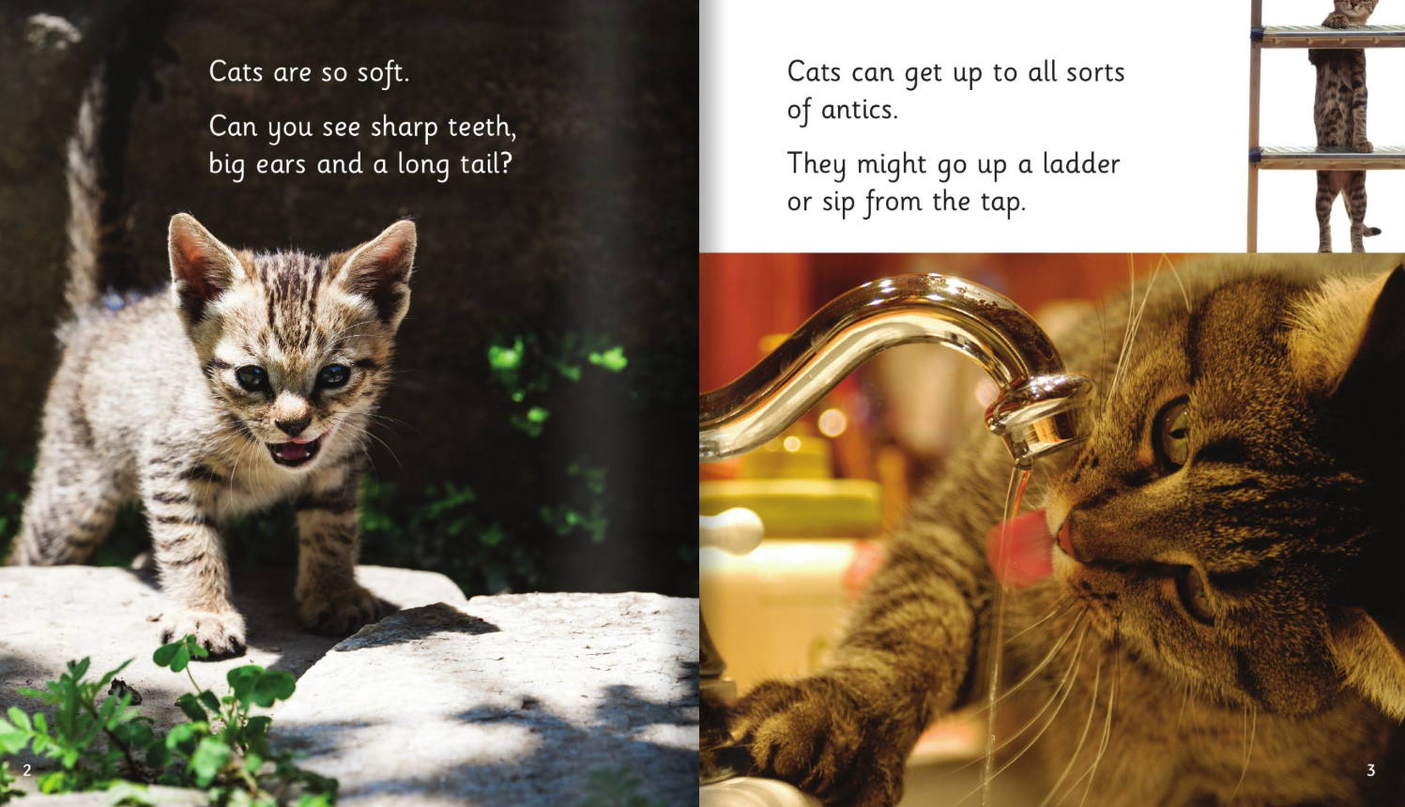

Slide 19
Phase 4

Slide 20
Working in Partnership
Supporting your child at home

Slide 21
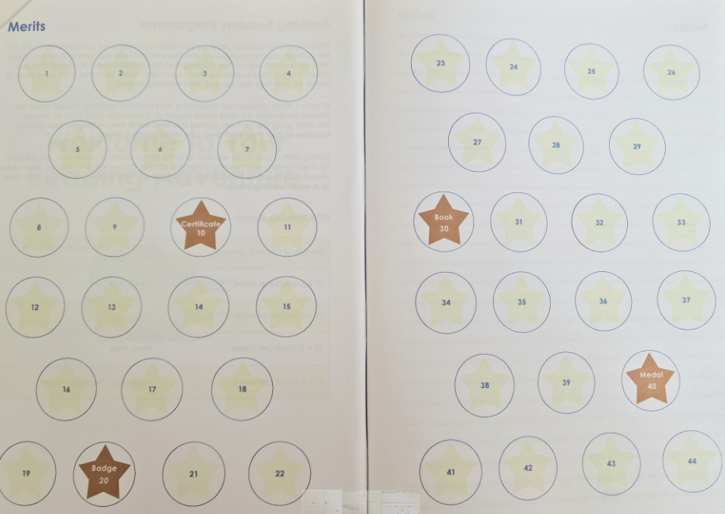
Reading for Fluency
Practicing reading skills 5 times a week

Slide 22
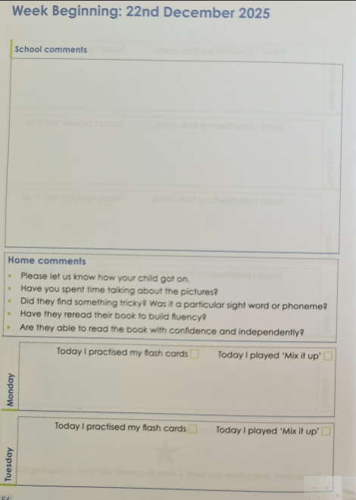

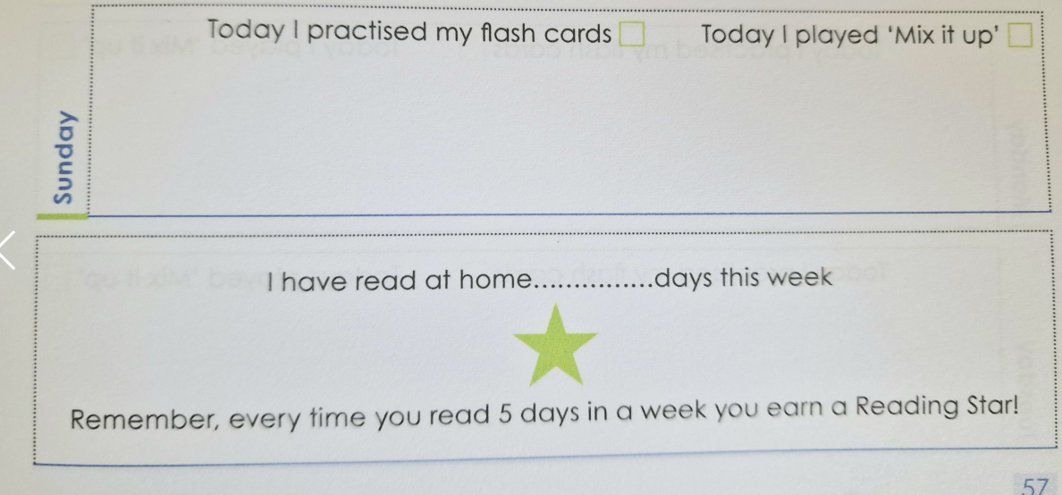
Earning Reading Stars
Reading and rereading your phonics book
Practicing your flashcards
Playing the ‘Mix it up’ game using words from your phonics book

Slide 23

Year 1 – Phases 4 (recap) and 5
Notes:
NOTE: To change images on this slide, select a picture and delete it. Then click the Insert Picture icon
in the placeholder to insert your own image.

Slide 24
Need to know vocabulary for Year 1
Split digraph
The e makes the first vowel say it’s name
eg. cake
Quadgraph
Four letters that make one sound,
eg. eigh
Suffix
A group of letters you add to the end of a root word
Eg. kicking
Prefix
A group of letters you add to the start of a root word
Eg. unhappy

Slide 25
Phase 5
Children now begin to learn how the phonemes that they have learnt so far, can be spelt in different ways. c cat k kit ck luck ch stomach

Slide 26
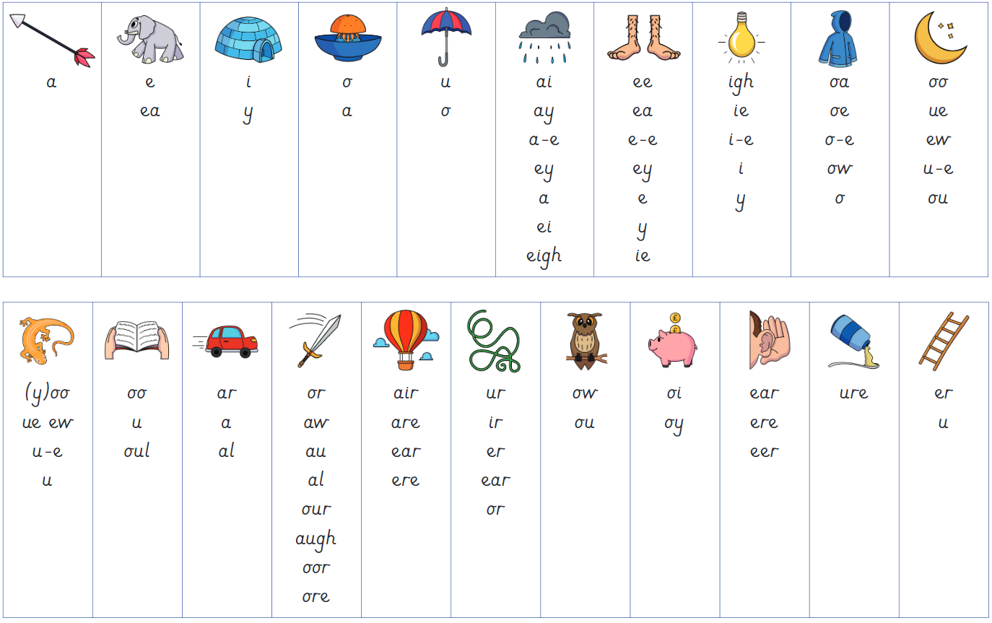
Phase 5

Slide 27
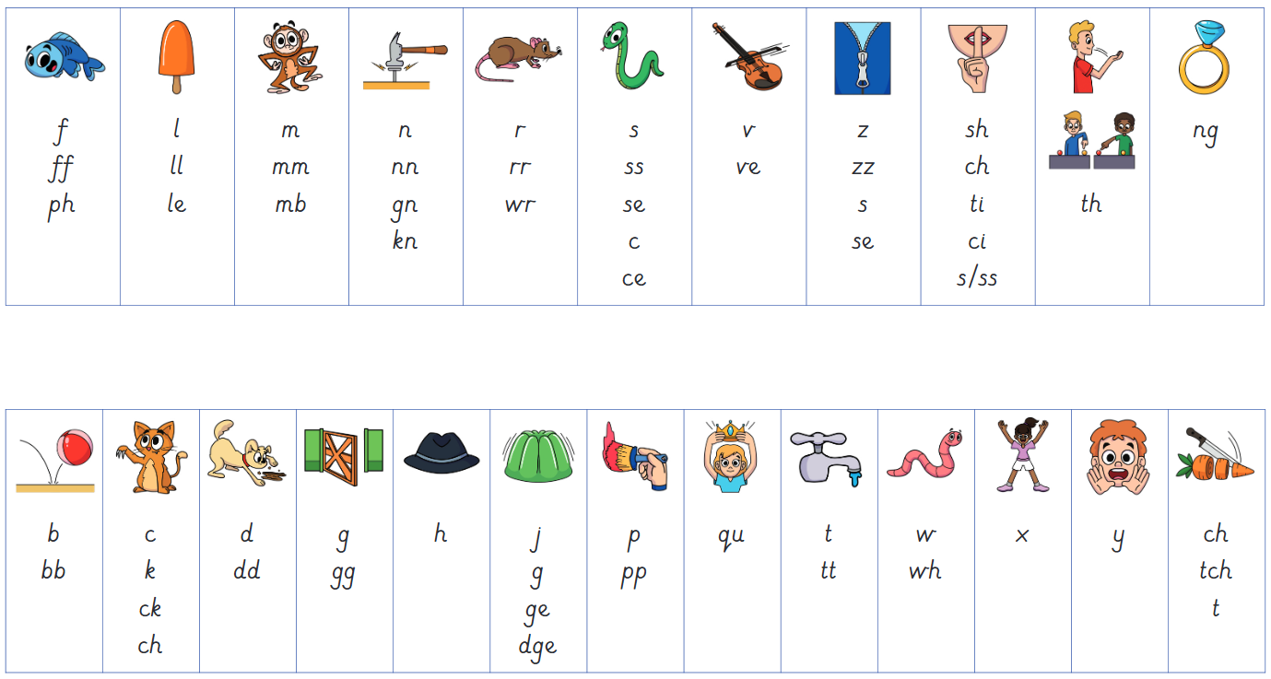
Phase 5

Slide 28
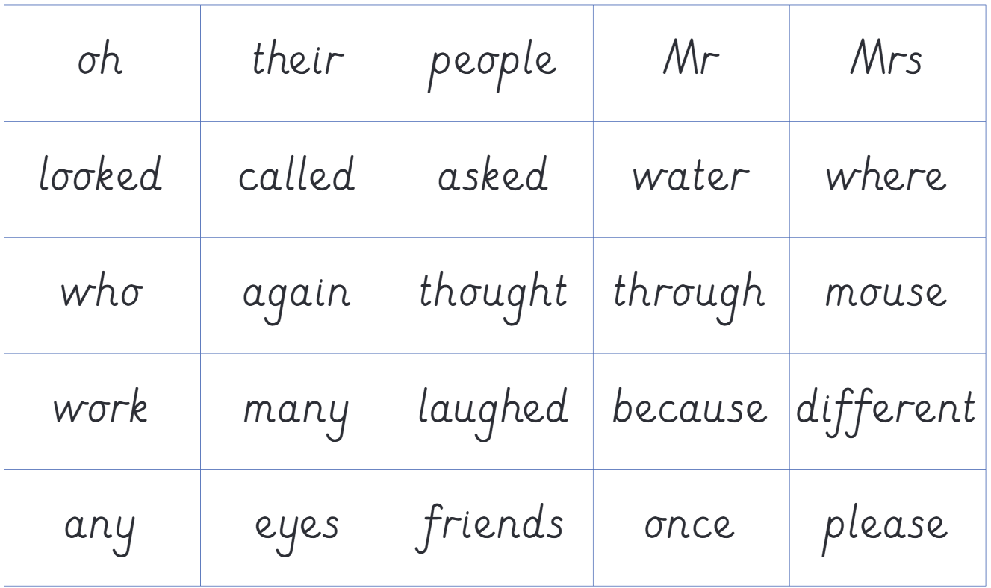
Phase 5

Slide 29
What phonemes and prefix / suffix can you see in this word?
haunted

Slide 30
Progress in reading:
Phase 5 (early and end)

Slide 31
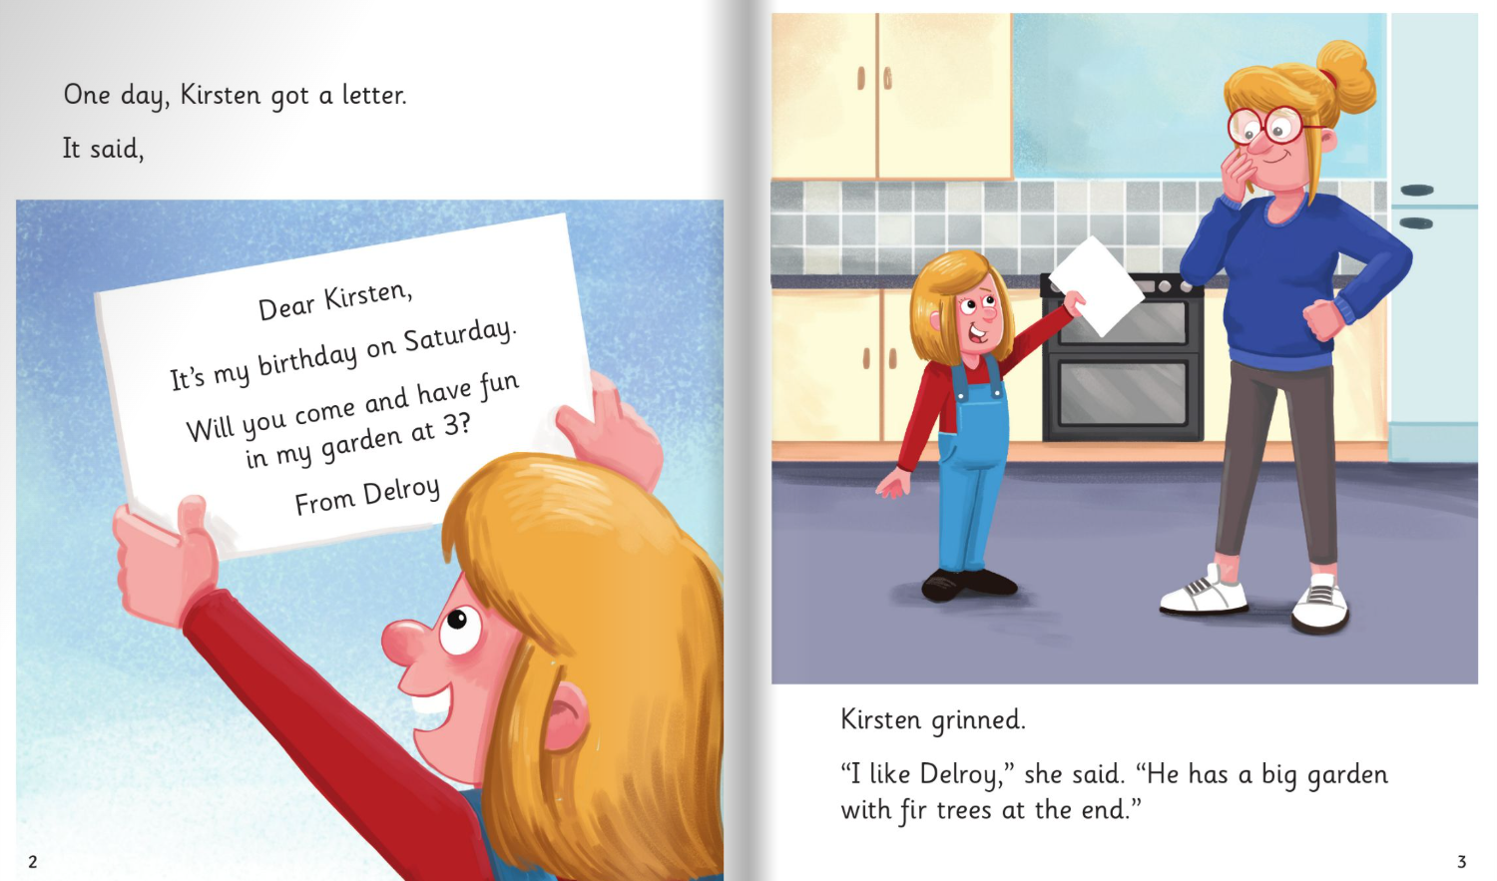

Slide 32
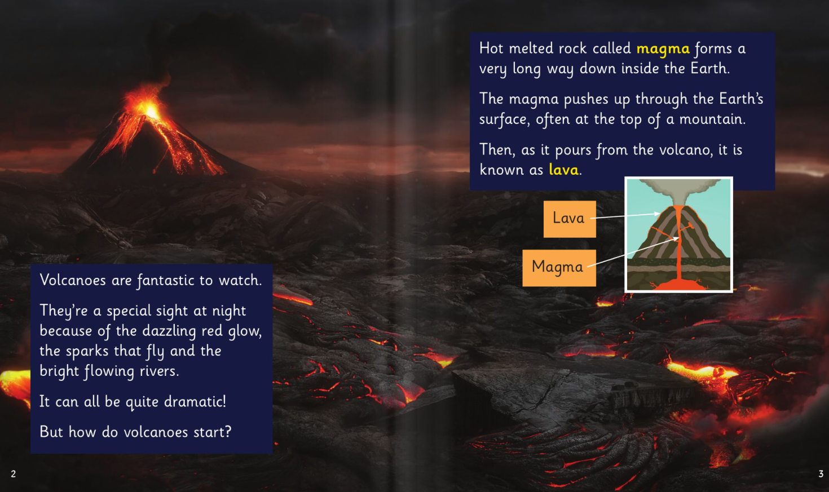

Slide 33
Phonics Screening Check
https://assets.publishing.service.gov.uk/media/68c815665e09a4a59af0beb1/Phonics_screening_check_information_for_parents.pdf

Slide 34


Slide 35
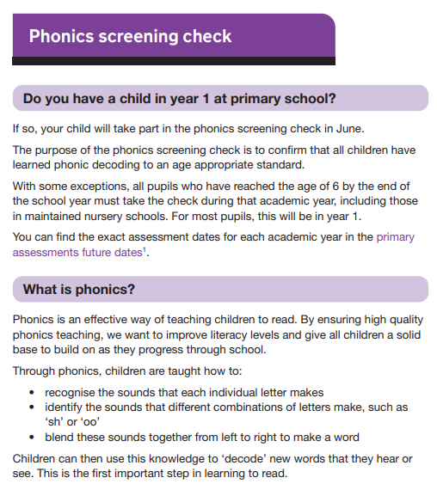

Slide 36
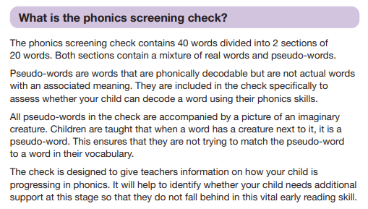

Slide 37
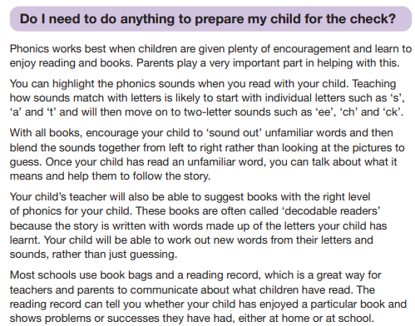

Slide 38
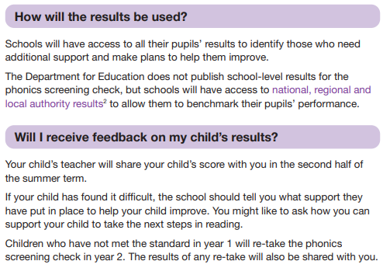

Slide 39
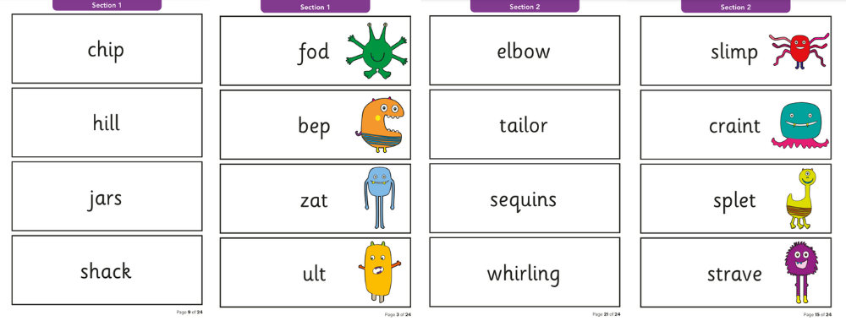
Sample pages from the Phonics Screening Check

Slide 40
Working in Partnership
Supporting your child at home

Slide 41
Reading for Fluency
Practicing reading skills 5 times a week
Reading and rereading your phonics book
Practicing your flashcards
Playing the ‘Mix it up’ game using words from your phonics book

Slide 42

Teach Your Monster To Read
5 minutes practising phonics on Teach Your Monster To Read, 3 times a week

