Slide 1

KS2 Parent Information
September 2023

Slide 2
Class Structure
KS2 is arranged into 4 classes
Year 3
Teacher: Mrs. Butler, Mrs. Brunet-Lua
T.A.: Mr. Kinsley,
Year 4
Teacher: Mrs. Farrier
T.A.: Mrs. Maddison, Mrs Kaya, Mrs Stephens
Year 5
Teacher: Mrs Sinclair & Mrs Brunet-Lua
T.A.: Mrs. Peters, Miss Stanley
Year 6
Teacher: Mrs Beasley, Mr Payne
T.A.: Miss Edwards & Ms Stock

Slide 3
Cam Everlands Primary
School Uniform
Children are asked to wear full school uniform:
Blue jumper or cardigan
Grey/ black trousers, skirt or pinafore dress
Grey shorts or blue and white checked summer dress
Blue polo t-shirt or shirt
Black shoes (boots can be worn in bad weather, with a
change of shoes in bags)
P.E. kit which includes a coloured t-shirt to support their house team

Slide 4
Why is reading so important?
Reading for pleasure is more likely to determine whether a child does well at school than their social or economic background.
Imagination and fun
Faster development of communication and speech
Enhanced concentration and discipline.
Cultural understandings.
Higher academic performance.
Nurturing the parent and child bond.

Slide 5

Aspiring Reading
Programme
At Everlands, we take part in a reading challenge. Children are asked to read at home at least 5x per week on different days.
Key Stage 2 Reading Rewards
5 days a week at home in a week. | Reading stamp in Learning Diary.
11 x 5 reads per week. | 11 Team Points.
22 x 5 reads per week. | Certificates.
33 x 5 reads per week. | Book Prize.
44 x 5 reads per week. | Dedicated Readers Medal.

Slide 6
Reading in School
The children will be given the opportunity to independently read every day (Reading for Fun).
We aim to teach whole class reading at least four times a week.
In Key Stage 2, we focus on fluency and both verbal and written comprehension, and we ask that when you are reading with your child at home that you ask them lots of questions.
All classes will aim to read to the children at least once per day.

Slide 7

Promoting Independence
In all lessons we try to ensure children take responsibility for their learning. We aim to promote independence in a variety of ways in the classroom, including:
Working walls
Access to equipment and concrete resources
Word mats
Peer assessment

Slide 8

Happy learners make great progress!
Various activities throughout the school day focus on promoting the children’s wellbeing and allowing them to reflect on their learning, relationships and feelings for example:
Worry boxes
PSHE lessons
Assemblies

Slide 9

Spellings
We actively try to teach spelling through focusing on sounds and word structure. Part of the school day is designated for this instead of ‘Look Cover Write Check’ sheets going home.

Slide 10

Learning Online
The school subscribes to several online learning providers: Purple Mash and Mangahigh.
Children can access these at home at any time; there are lots of fun games and activities to support your child’s learning.
A personal log-in and password for these online resources will be added to the front of your child’s planner.

Slide 11

P.E.
Swimming is on a Tuesday afternoon each week. Year 6, 5 and 4 are swimming in term 1 & 2. Year 3 will learn in term 3-4
P.E. kit:
Indoor kit: Plain blue or black sweatshirt and jogging bottoms.
Plain black or blue shorts.
Plain t-shirt of your child’s house colour.
Trainers for P.E.
We would ask that children do not wear multi-coloured, sparkly or fashion items for their PE lessons.
Earrings: Studs only.

Slide 12
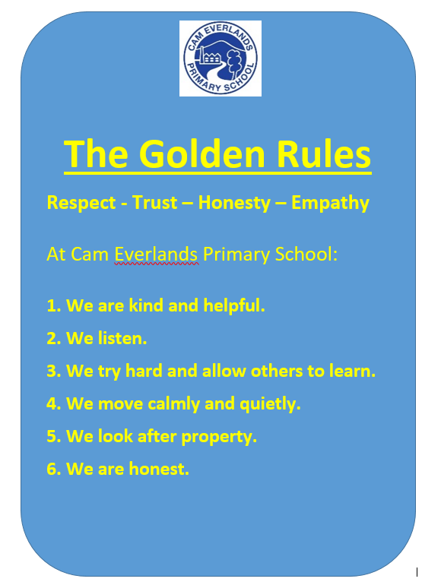
Behaviour

Slide 13
We have 2 key principles at Cam Everlands
Everyone has the right to feel safe, valued and respected
  Everyone has the right to learn and teach free from the disruption of others

Slide 14
This means…
Nobody has the right to make anyone else feel unsafe, not valued or disrespected
  Nobody has the right to stop anyone else learn or teach by being disruptive

Slide 15

Cam Everlands Goals
The Cam Everlands Goals will help you be a great learner.

Slide 16

Class Dojo
We are now using Class Dojo as a reward system for the children to reward positive behaviour
If you’ve signed up, you can get notifications when your child gets a reward
Individual points go towards a personal reward and we are also using them to count towards teams as well
You can message teachers using Dojo but it doesn’t notify them. Emails are still the best way to contact staff (although please be mindful that staff may not respond between 5pm and 8am)

Slide 17
Food and drink
We are a nut-free school – please do not send in food and snacks which contain nuts
All snacks which are sent in should be healthy e.g. fruit, vegetables, NOT crisps and chocolate
We want children to be hydrated but we children should only be drinking water in school

Slide 18
Other reminders
Unless explicitly agreed to by school, children should not bring toys to school
Again, unless specified on a plan, children should not be bringing fidget toys into class

Slide 19
Key Dates
18&19/10/23 Parents Evening
25/10/23 School Association Disco
6 - 10/11/23 Y6 Residential
24/11/22 School Association Disco
8/12/23 Christmas Fayre
21& 22/2/24 Parents Evening
13/5/24 Y6 SATs week begins
6/6/24 Sports Day
5/7/24 Y5/Y6 Production

Slide 20
Any Questions?
If you have any questions, we will all go to our classrooms to speak to you individually.
Thank you very much. ☺

